Slide 1
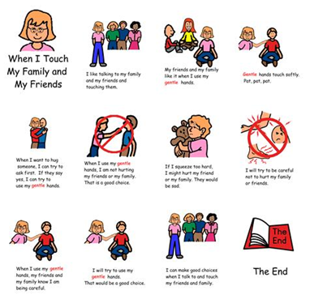
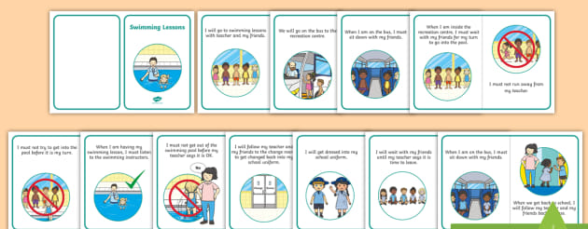
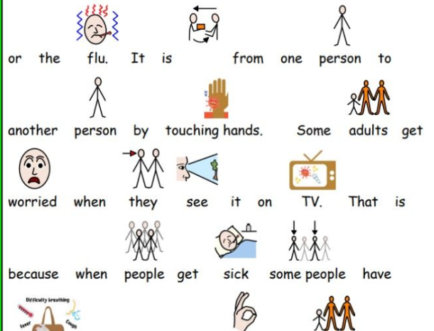
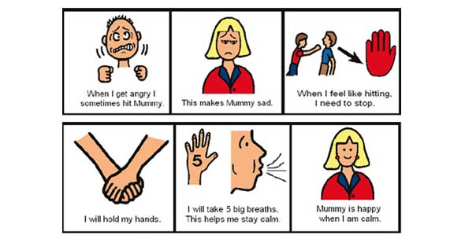
Social stories
An introduction to social stories.
Mahala Carter-Slinn

Slide 2
What is a social story?
Social stories were created by Carol Gray in 1991.
They are short descriptions of a particular situation, event or activity, which include specific information about what to expect in that situation and why.
Social stories can be used with all children regardless of age or diagnosis.

Slide 3
When can I use a social story?
Social stories can be used to:
develop self-care skills (eg how to clean teeth, wash hands or get dressed), social skills (eg sharing, asking for help, saying thank you, interrupting).
help someone to understand how others might behave or respond in a particular situation
help others understand the perspective of an autistic person and why they may respond or behave in a particular way
help a person to cope with changes to routine and unexpected or distressing events (eg absence of teacher, moving house, thunderstorms)
provide positive feedback to a person about an area of strength or achievement in order to develop self-esteem
as a behavioral strategy (eg what to do when angry, how to cope with obsessions).

Slide 4
Why should I use a social story?
Social stories present information in a literal, 'concrete' way, which may improve a person's understanding of a previously difficult or ambiguous situation or activity. The presentation and content can be adapted to meet different people's needs.
They can help with sequencing (what comes next in a series of activities) and 'executive functioning' (planning and organising).
By providing information about what might happen in a particular situation, and some guidelines for behaviour, you can increase structure in a person's life and thereby reduce anxiety.
Creating or using a social story can help you to understand how the autistic person perceives different situations.

Slide 5
How to write a social story
Keep it as short and simple as possible.
Carol Gray says you need to;
Picture the goal
Gather the information
Tailor the text.

Slide 6
Picture the Goal
Consider why you need this story, what is it you want to teach the child. For example washing hands before lunch.
Think about what information the child needs to understand in order to achieve this goal. For example why washing your hands before Lunch is needed, i.e you have germs on your hands and will spread the germs into your mouth when you eat your sandwich which will make you sick.

Slide 7
Gather the information
Collect information about the scenario you want to describe in your social story; where does it occur? When does it begin/end? Who will be there? How long for? Why?
If a particular outcome is not garunteed use words such as ‘sometimes’ or ‘usually’.
Gather information around the child’s reading ability, age and interests in order to tailor the story according to the child.

Slide 8
Tailor the Text
A social story needs to have a title, introduction, body and conclusion and should use patient and supportive language.
It should answer six questions: where, when, who, what, how and why?
It should be made up of descriptive sentences, and may also have coaching sentences.
A descriptive sentence accurately describes the context, such as where the situation occurs, who is there, what happens and why, eg:
Christmas Day is 25 December.
Sometimes I get sick.
A coaching sentence gently guides behaviour, eg:
I will try to hold an adult’s hand when crossing the road.
It’s ok to ask an adult for help with nightmares.
When I am angry, I can take three deep breaths, go for a walk or jump on the trampoline.

Slide 9
Using the social story
Think about engaging the child. Could you include questions? Blank spaces for the child to fill in? could the child create a poster about the social story?
Create a plan of when to review the social story with the child and how often.
Ensure you present the social story when everyone is calm and relaxed.

Slide 10
For more information/support
Talk to your Speech and Language therapist in school.
National Autistic society website https://www.autism.org.uk/about/strategies/social-stories-comic-strips.aspx
The new Social Story book: 15th Anniversary Edition, Carol Gray 2015

